Slide 1
Car Price Prediction Project
By – Harsh Prasad

Slide 2
Problem Statement
1. With the covid 19 impact in the market, we have seen lot of changes in the car market. Now some cars are in demand hence making them costly and some are not in demand hence cheaper. One of our clients works with small traders, who sell used cars. With the change in market due to covid 19 impact, our client is facing problems with their previous car price valuation machine learning models. So, they are looking for new machine learning models from new data. We have to make car price valuation model.

Slide 3
Understanding
1. The pandemic-induced lockdown resulted in the shutting down of production at original equipment manufacturers (OEM). It also led to disruption of the entire value chain of major industries in India, and therefore negatively affected production of auto spare parts in micro, small and medium-sized industries. In addition, the reduction in consumer demand for passenger vehicles contributed to a loss in revenue and a severe liquidity crisis in the sector.
2. Used cars will continue to see a faster recovery in demand and much will depend on the supply catching up to the same.
After facing back-to-back setbacks because of demonetization and GST, the used car market has witnessed healthy demand momentum and has outperformed new car sales in the last two years.
With the change in market due to covid 19 impact, previous car price valuation machine learning models are not working efficiently. So, we are looking for new machine learning models from new data
3. You are required to model the price of houses with the available independent variables. This model will then be used by the management to understand how exactly the prices vary with the variables. They can accordingly manipulate the strategy of the firm and concentrate on areas that will yield high returns. Further, the model will be a good way for the management to understand the pricing dynamics of a new market.

Slide 4
Understanding
5. We propose to use machine learning algorithms and artificial intelligence techniques to develop an algorithm that can predict used car prices based on certain input features.2. In India, there are multiple real estate classified websites where properties are listed for sell/buy/rent. However, in each of these websites we can see lot of inconsistencies in terms of pricing of an apartment and there are some cases when similar apartments are priced differently and thus there is lot of in-transparency.
6.Also, Public transport and shared mobility modes are considered more or less safe again with regard to COVID-19 infection. People are wary of taking public transport for commuting. Small family cars are in prime demand.
The increased preference for personal mobility due to safety concerns amid the Covid-19 pandemic has led to supply constraints in the used car market, as people are holding on to their cars longer.

Slide 5
Exploratory data analysis
1.Importing the dataset:
importing the dataset using the “read_csv()” function of the Pandas library. This function can read a CSV file (either locally or through a URL) and also perform various operations on it.
dataset = pd.read_csv("cleaned used car data.csv")
2.Extracting the independent variable.
To extract the independent variables, we used drop function of the Pandas library.
x = dataset_new.drop(“price", axis = 1)
here dataset_new is the data set which contains the independent and
dependent variable.dropping the price variable from the dataset and storing it in other variable y.

Slide 6
Exploratory data analysis
3. Extracting dependable variable.
To extract the independent variables, we used drop function of the Pandas library.
y = dataset_new[“price”]
here dataset_new is the data set which contains the independent and dependent variable. Storing the label variable from the dataset and storing it in other variable y.
4.Removing outiers from the data using Z score.
5.Splitting the data and then removing skewness.
6.removing skewness from the data.

Slide 7
Exploratory data analysis
7. Scaling the data using standard scaler so that there is no biasness during model learning.
8. Using PCA for feature selection.
9. Splitting the data:
x_train,x_test,y_train,y_test = train_test_split(x,y,test_size = .20,random_state = 1312)

Slide 8
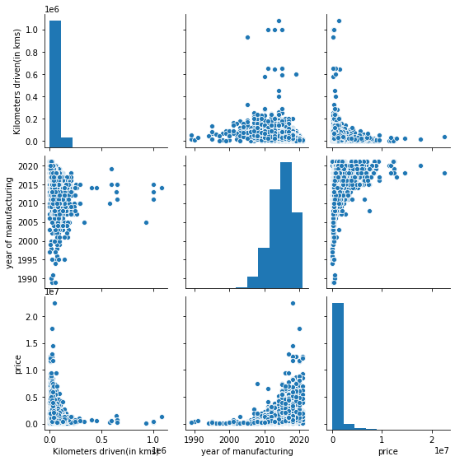
Visualization

Slide 9
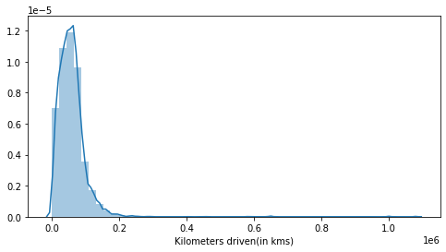
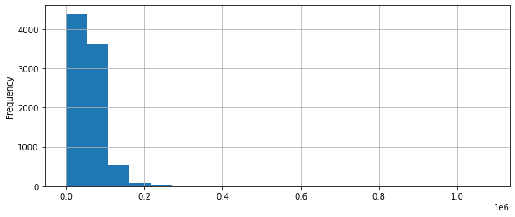
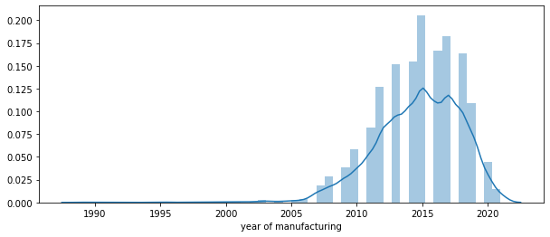
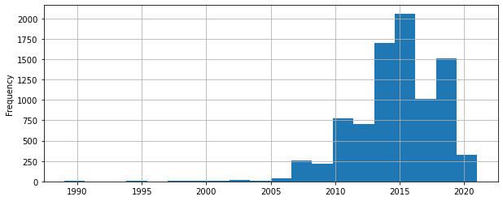

Slide 10
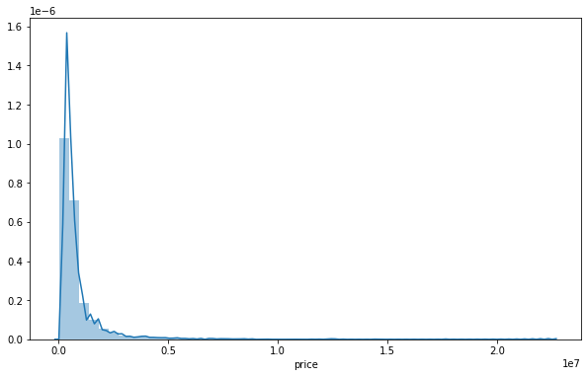
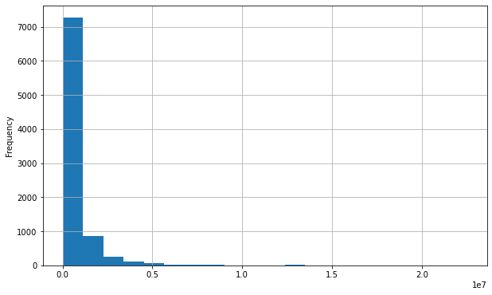
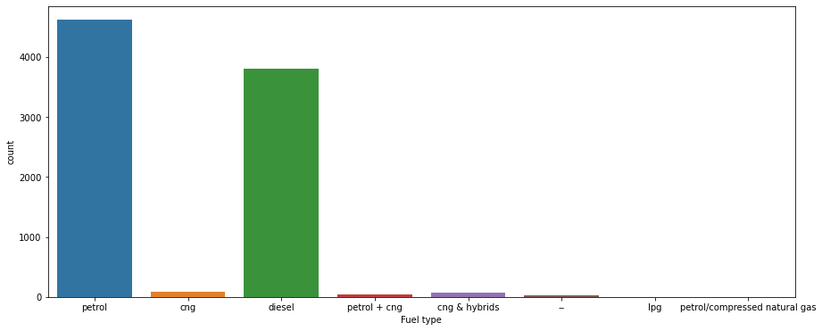

Slide 11
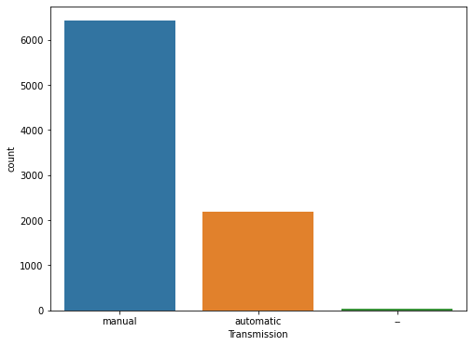
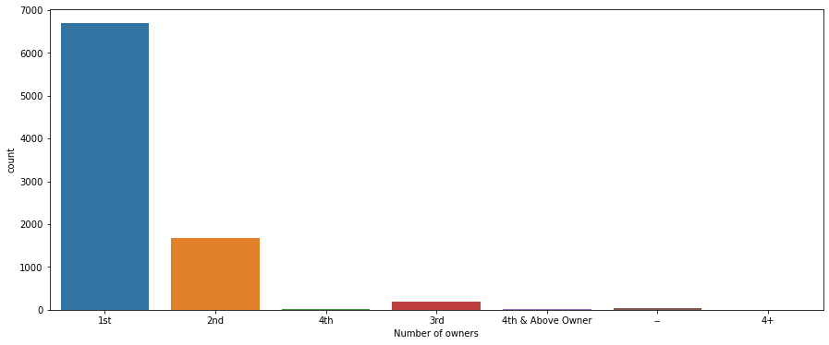

Slide 12
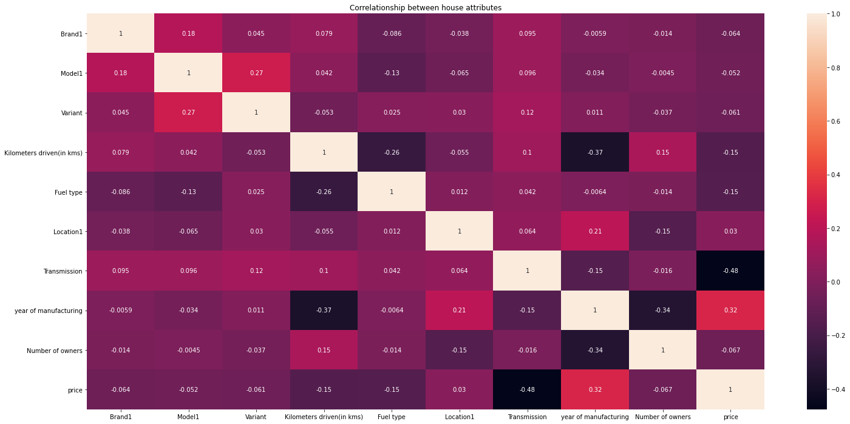

Slide 13
Steps and assumption.
1.We did not drop any feature as there was not much difference in the accuracy after using feature selection technique.
2.Not losing the data more than 8 percent.
3.The features which showed linear positive relation with each other will show same relationship with other features.

Slide 14
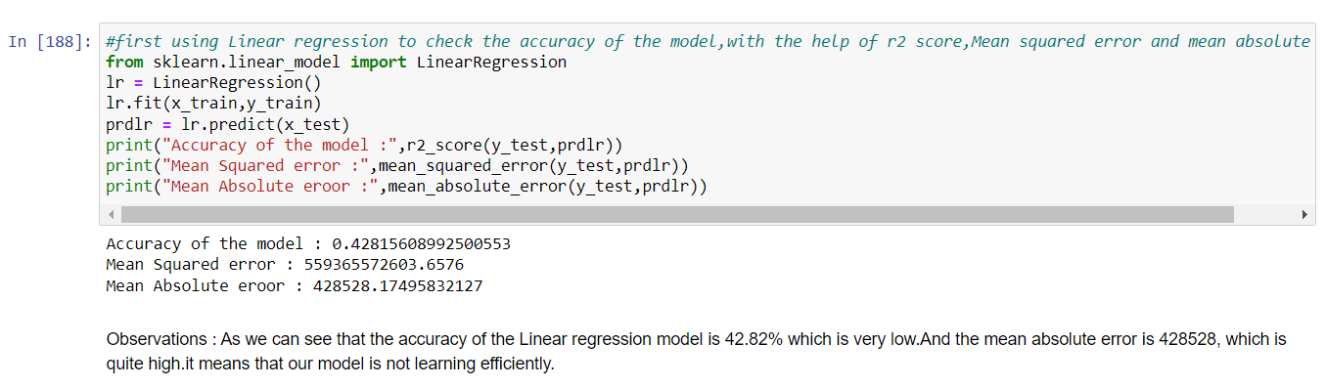
Model selection
1.Linear Regression

Slide 15
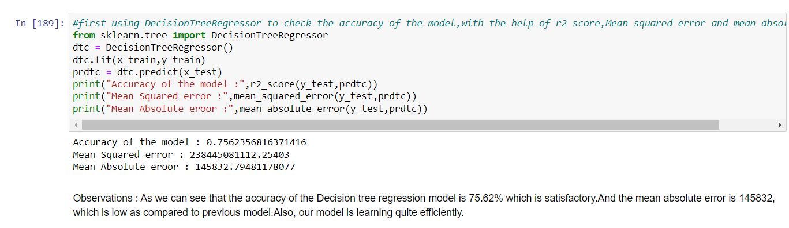
Model selection
2.Decision Tree Regressor

Slide 16
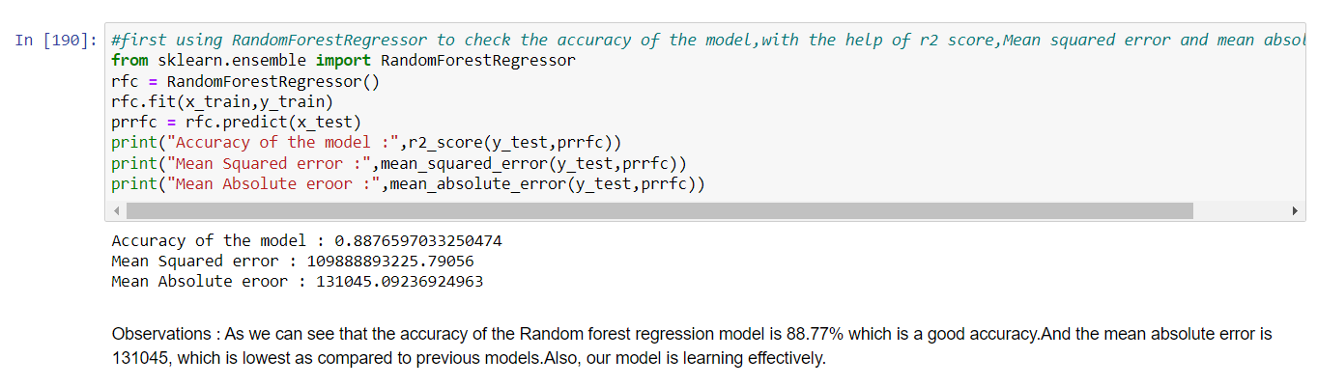
Model selection
3.Random Forest Regressor

Slide 17
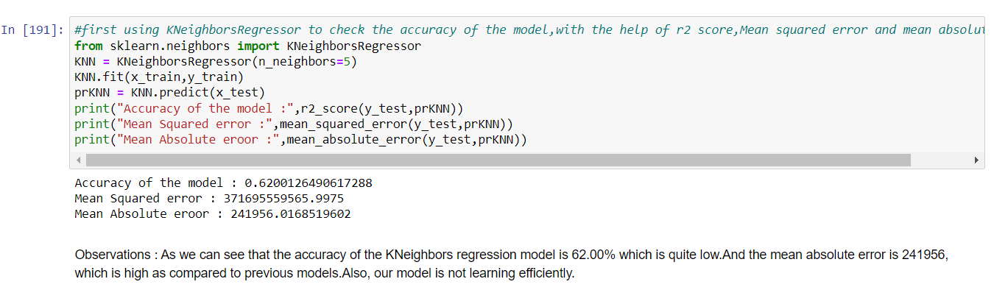
Model Selection
4.KNNeighbor Regressor

Slide 18
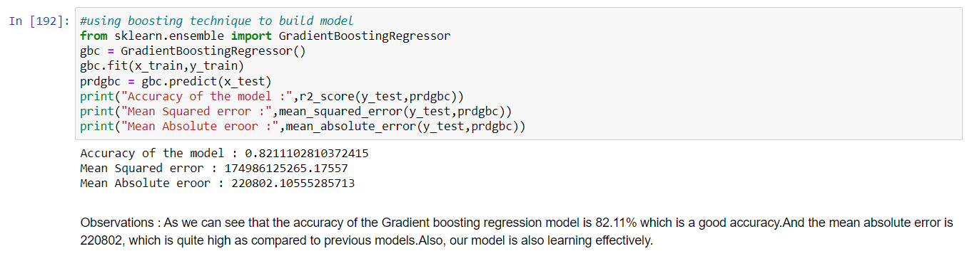
Model Selection
4.Gradient Boosting Regressor

Slide 19
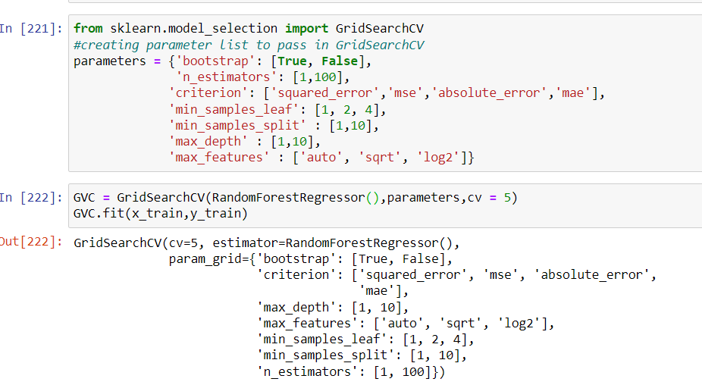
Final Model
Random Forest Regressor(after hyperparameter tuning)

Slide 20
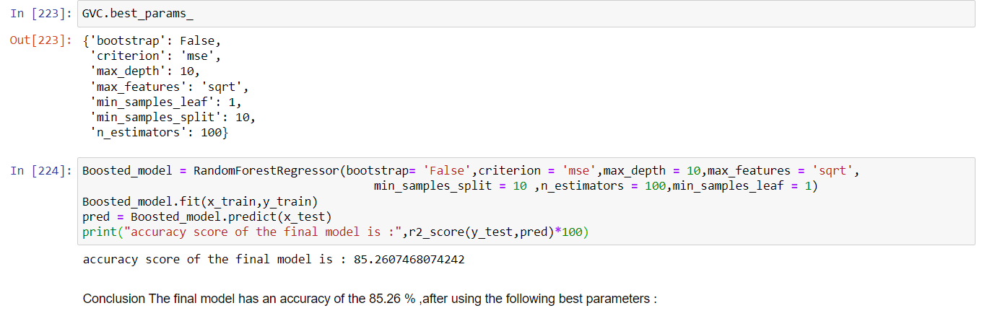
Final Model
Random Forest Regressor(after hyperparameter tuning)

Slide 21
Conclusion
By performing different models, it was aimed to get different perspectives and eventually compared their performance. With this study, it purpose was to predict prices of used cars by using a dataset that has 10 predictors and 8868 observations. With the help of the data visualizations and exploratory data analysis, the dataset was uncovered and features were explored deeply. The relation between features were examined. At the last stage, predictive models were applied to predict price of cars in an order: random forest, linear regression, KNeighbors regression, Decision Tree Regression, Gradient Boosting regression.

